Slide 1


Autonomous Navigation System for Factory Floor Robots (AGVs)
Team Members:
Pavitra A
Paroma Dhara
Nivetha G K
Pranakanth C
Neeraj Raghav V R
Niranjan S
Pranav Venkateswaran

Slide 2

Content
Proect Overview
Problem Statement
Project Goal and Objectives
Proposed Solutions
Resources Utilized
System Design
Implementation Details
Advantages and Limitations
Future Scope
Conclusion

Slide 3
Project Overview
This project aims to build an Autonomous Navigation System for Automated Guided Vehicles (AGVs) operating on factory floors.
It uses Ultrasonic, Infrared (IR), and PIR sensors to detect obstacles and human presence in real-time.
The project falls under the domains of Industrial IoT, Embedded Systems, and Smart Robotics, contributing to the broader vision of Industry 4.0 and intelligent automation.
Embedded systems via Raspberry Pi Pico W ensure on-device sensing and decisions, while cloud-based Machine Learning allows for long-term optimization, such as identifying bottlenecks and improving navigation based on historical data.
This hybrid approach balances low-latency local response with smart global improvements.

Slide 4
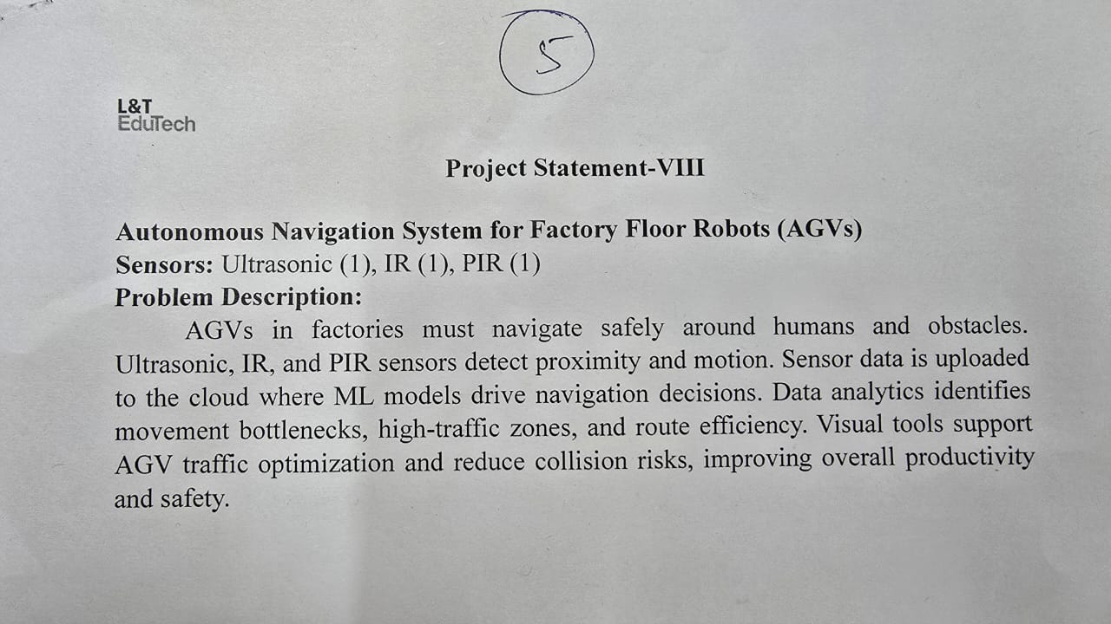

Slide 5
Problem Statement
AGVs often face challenges navigating factory floors with unpredictable human movement and dynamic obstacles.
Traditional systems rely on static paths or expensive hardware like LIDAR, which lack flexibility and cost-efficiency.
Failures in AGV navigation can lead to collisions, bottlenecks, production delays, and safety hazards.
In high-density industrial environments, optimizing AGV paths with accurate, real-time sensing and smart rerouting is critical to both productivity and worker safety.

Slide 6
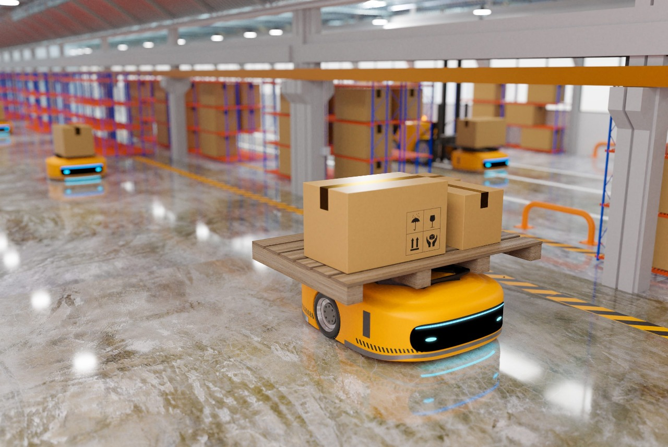
Project Goal & Objectives
Build smart AGV navigation with sensors & cloud.
Integrate Ultrasonic, IR and PIR sensors with Raspberry Pi Pico W.
Stream sensor data to ThingSpeak cloud.
Generate and download CSV dataset logs.

Slide 7
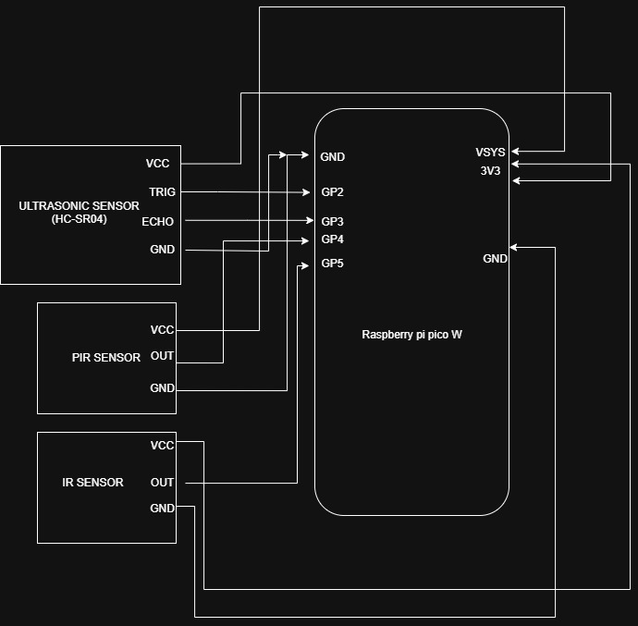
Proposed Solution
Embedded System + ML Integration:
Embedded board processes & transmits data
Cloud ML predicts future sensor readings (1-hour forecast)
Predictions used for traffic optimization & collision avoidance

Slide 8
Resources Utilized
Hardware: Raspberry Pi Pico W, Ultrasonic Sensor, Infrared Sensor, PIR Sensor
Software & Tools: Thonny IDE, ThingSpeak, Wokwi, MS Excel
Datasets/ML Models Used:
- Source: ThingSpeak Cloud
- Type: CSV file
- Size:

Slide 9
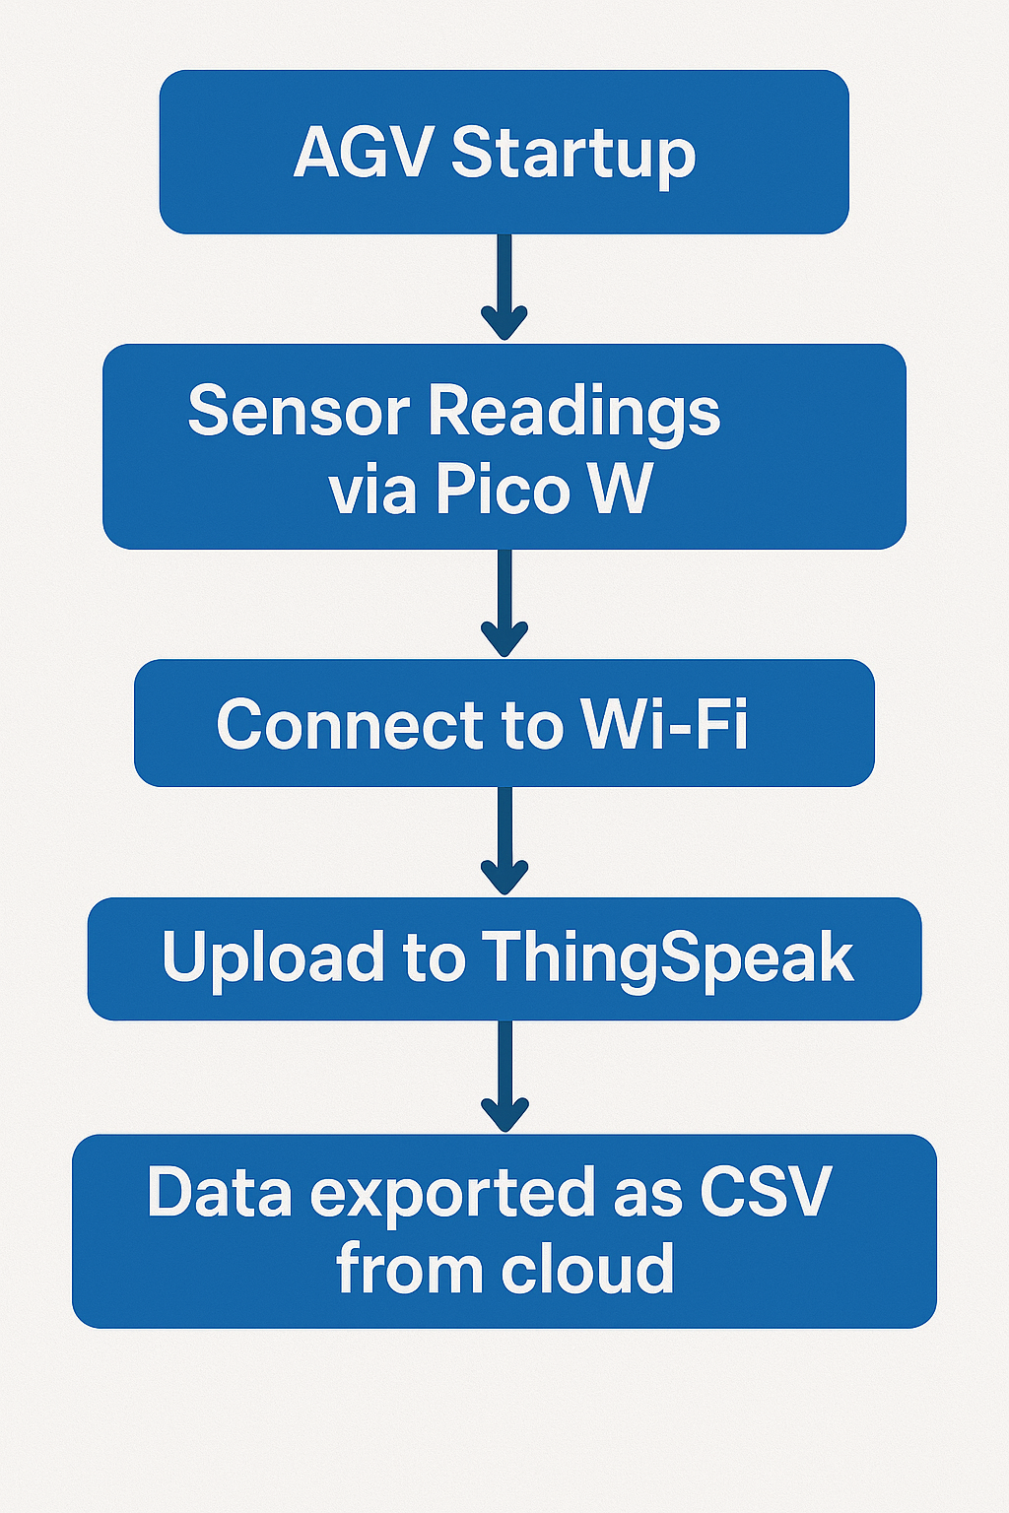
System Design
Inputs (to Raspberry Pi Pico W):
Ultrasonic Sensor – Distance measurement for obstacle detection
IR Sensors – Line following or edge detection
PIR Sensor - Motion detection
Outputs (from Raspberry Pi Pico W):
Wi-Fi Module (built-in on Pico W) – Sends data to ThingSpeak cloud
CSV Export – Dataset generated will be available for download from ThingSpeak

Slide 10
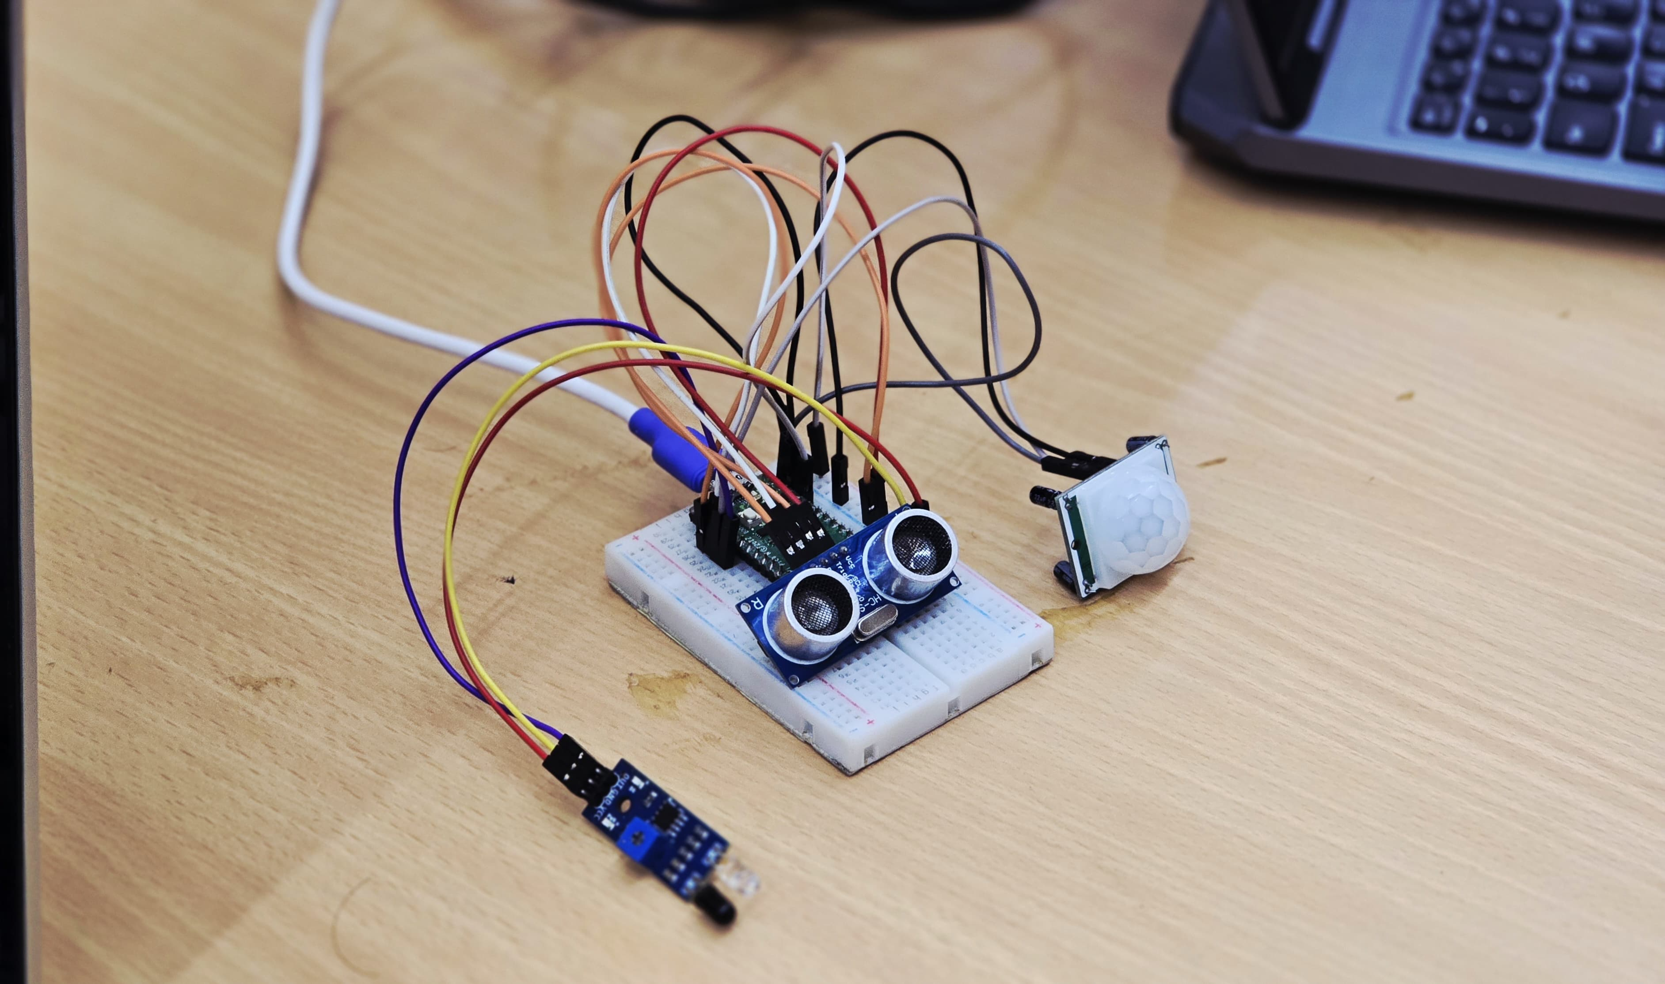
Implementation Details
Hardware and Micropython setup:
Raspberry Pi Pico W and sensors are configured
GPIO wiring
Thonny IDE
Wi-Fi and ThingSpeak Integration:
Credentials set up
Channel ID, API keys
Data Logging and Cloud export:
Real-time sensor data
Auto-updating graphs
Export the csv file

Slide 11
Advantages & Limitations
Advantages:
Low-Cost Implementation
Wireless Data Logging
Limitations:
Limited Processing Power
Basic Security

Slide 12
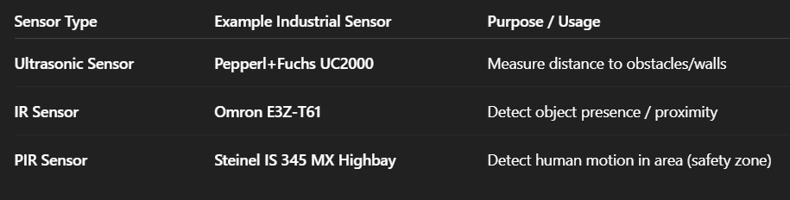
Future Scope
Dynamic Route Recalculation
Integrate real-time alternate path planning using obstacle detection
Useful for AGVs in dynamic warehouse or factory environments
Advanced Sensor Integration
Upgrade to LiDAR, 360° cameras, IMUs for precision navigation
Enables accurate mapping and obstacle avoidance

Slide 13
Conclusion
Successfully interfaced sensors with Raspberry Pi Pico W
Enabled wireless data logging using ThingSpeak cloud
Achieved real-time monitoring and CSV export for analytics
Laid foundation for scalable AGV systems with smart navigation potential

Slide 14
Thank you

